Slide 1
Tax and Fiscal Reponse to Low Fertility and Population Aging in South Korea
Sungjin Kim

Slide 2
Contents
I. Current Situation of Fertility and Population Aging
II. The Impact of Low Fertility and Population Aging
III. Policy Response over the last 15Years (2006-2021)
IV. Policy Directions and Tasks of New Administration : Overview
V. Tax Incentive and Budget for Main Projects
VI. Conclusion and Recommendations

Slide 3
I. Current Situation of Fertility and Population Aging

Slide 4
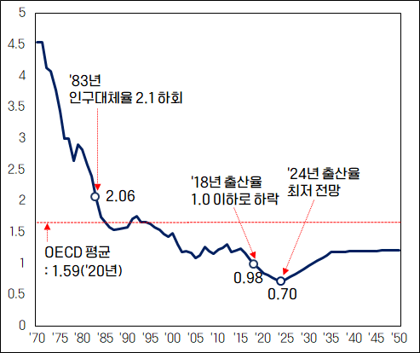
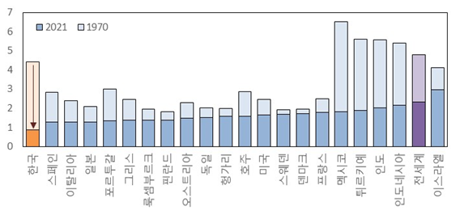
I
Current Situation of Fertility and Population Aging
1. Low Fertility : Continuous decline in Total Fertility Rate
TFR was declined to 0.78 in 2022
- the lowest out of 198 nations
- only country below 1.0
Forecasted 0.7 in 2024
<TFR Trend>
< TFR: Cross-Country>
S.Korea
Spain
Italia
Japan
Portugal
Greece
Luxembourg
Finland
Austria
Germany
Hungary
Australia
USA
Sweden
Denmark
France
Mexico
Turkey
India
Indonesia
World Avg.
Israel
1983) Population Replacement
Rate under 2.1
2024) Lowest BR
ever forecasted
2018) BR under 1.0
2020)
OECD Avg. 1.59
* Source : Statistics Korea, Future Population Forecast
* Source : Statistics Korea, Future Population Forecast

Slide 5
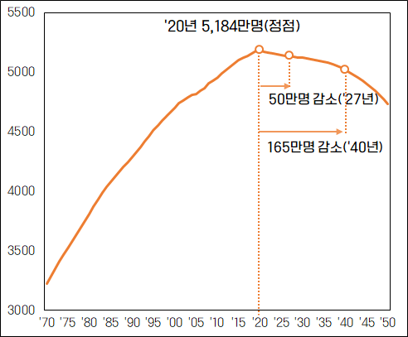
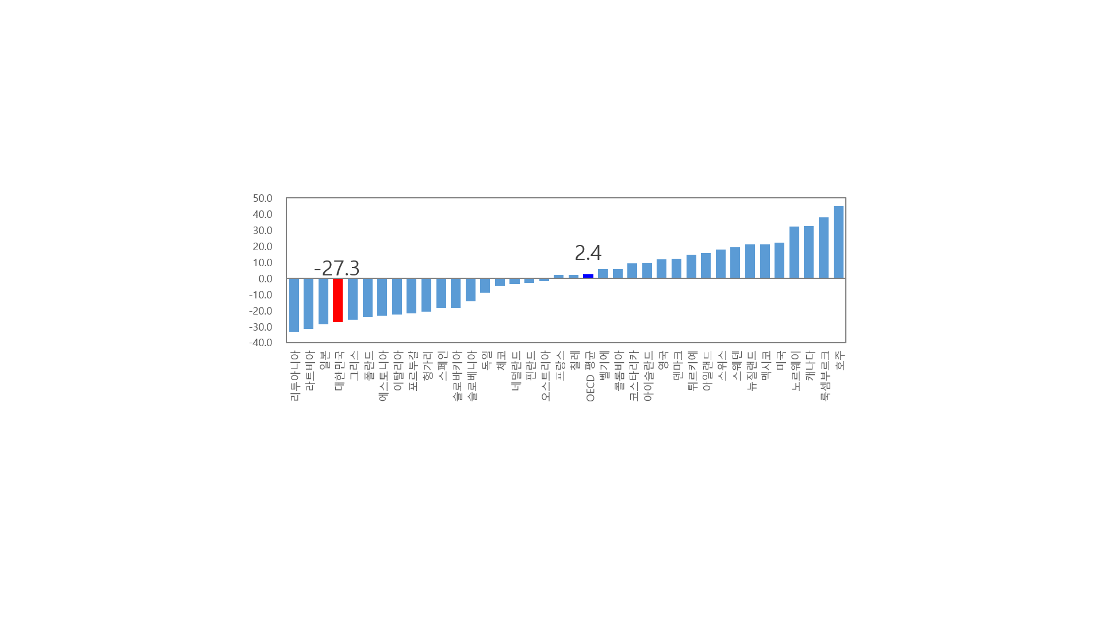
I
Current Situation of Fertility and Population Aging
2. Decline in Population : Peak in 2020 (51.84 Million)
Forested to decline 27.3% (37.66 Million) in 2070 compared to 2020 (between 1920 and 70 12.41Million declined)
- Ranked at 2nd among 29 nations with population over 50million, 4th in OECD 39 nations
< S. Korea Population Trend (ten-thousand) >
< Rate of Population Change in OECD Countries(%) >
2020) 51.8 mil . (peak)
Lituania
Latvia
Japan
S.Korea
Greece
Poland
Estonia
Italia
Portugal
Hungary
Spain
Slovakia
Slovenia
Germany
Czech Rep.
Netherlands
Finland
Austria
France
Chile
OECD Avg.
Belgium
Columbia
Costa Rica
Iceland
Great Britain
Denmark
Turkey
Island
Swiss
Sweden
New Zealand
Mexico
USA
Norway
Canada
Luxembourg
Australia
2027) △0.5 mil
2040) △1.65 mil
* Source : Statistics Korea Future Population Forecast
* Source : Statistics Korea Future Population Forecast, UN World Population Prospects

Slide 6
I
Current Situation of Fertility and Population Aging
3. Population Aging : Entered Aging Society in 2018
Forecasted “Super-aged Society” in 2025 (Taking only 7 years)
Due to baby boom generation (1955-63, 7.1 million) entering Aging society
The Quickest speed in the world.
<Total years between Aging and Super-aged Society >
France | U.S. | Japan
29 yrs | 15 yrs | 11 yrs

Slide 7
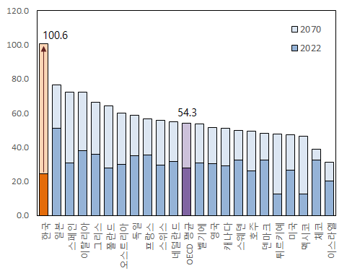
I
Current Situation of Fertility and Population Aging
3. Population Aging : Entered Aging Society in 2018
The ratio of Aging population to Total Population is forecasted highest in the world after 2045
(’70) 3.1% (’22) 17.5 (‘40) 34.4 (‘70) 46.4%
The old age support rate will increase most rapidly
(’22) 24.6 / 56th → (‘70) 100.6 / 1st
<The old age support rate in major countries>
S.Korea
Japan
Spain
Italia
Greece
Poland
Austria
Germany
France
Swiss
Netherlands
OECD Avg.
Belgium
Great Britain
Canada
Sweden
Australia
Denmark
Turkey
USA
Mexico
Czech Rep.
Israel
* Source : Statistics Korea Future Population Forecast, UN World Population Prospects

Slide 8
II. The Impact of Low Fertility and Population Aging

Slide 9
II
The Impact of Low Fertility and Population Aging
1. Short term : Beginning of the Shrinking Society
(1) Sharp reduction of the School-age population both in elementary and college level
- over capacity of educational infrastructure, idle space, facilities and equipment.
- financial problems of local colleges
(2) Sharp decrease in Military resources
- Difficulties in recruit, operation and overall national defense
(3) Regional extinction
- Extinction risky area reaches 49.6% of total local government
- Sharp increase of Social cost caused by population concentration around metropolitan area

Slide 10
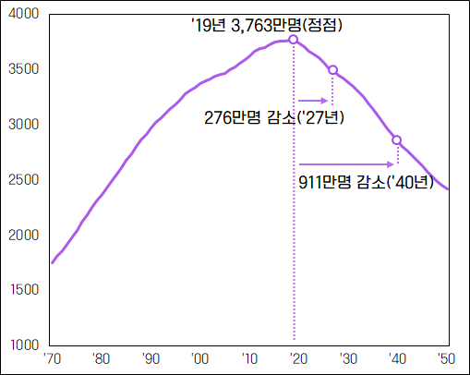
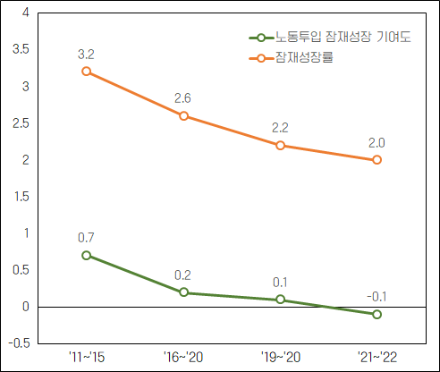
II
The Impact of Low Fertility and Population Aging
2. Mid-term : Weakness in potential of growth due to declining
labor force population and aging
(1) Labor force population
- LFP has been decreased continuously since its peak in 2019
* 300-500 thousand per year
* decreasing rate of youth population (19-34 yrs) -35.3% between ’20 and ‘40
- Shrinkage of consumption, investment and potential growth
- Reduction of Tax Revenue and Social security contributions
<Trend of Labor Force Population>
< Labor Input & Potential Growth Rate Contribution >
2019) 37.6 mil. (peak)
Labor Input Contribution
Potential Growth Rate
2027) △2.8 mil.
2040) △9.1 mil.
* Source : Statistics Korea Future Population Forecast
* Source : Bank of Korea

Slide 11
II
The Impact of Low Fertility and Population Aging
2. Mid-term : Weakness in potential of growth due to declining
labor force population and aging
(2) Population Aging : Weakness in potential of growth and expansion of the elderly poor caused by super-aged society
- Increase of aged labor force affect potential of growth
* low productivity
- Korean poverty ratio of the old/elderly is the highest (38.9%)
* OECD average (13.5%)
- Needs for expanding expenditure in aging supporting programs

Slide 12
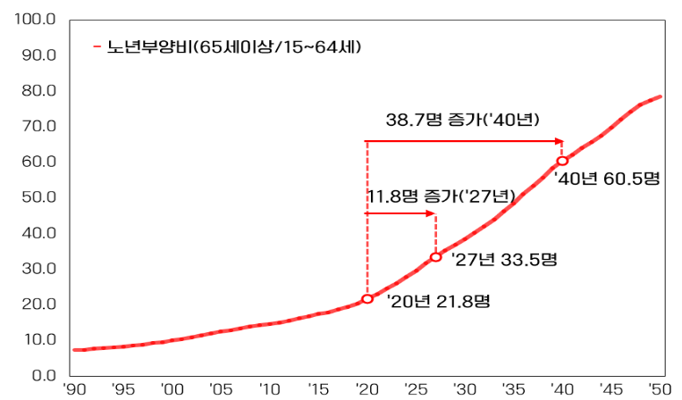
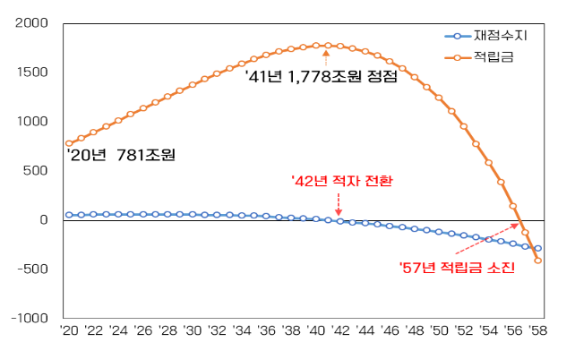
II
The Impact of Low Fertility and Population Aging
3. Long term : Lowering stability of welfare system due to sharp
increase in the old age support rate.
1) After 2030 baby boom generation (born in ’55-’63) will enter super-aging (over 75yrs)
* Old age support rate : (’20) 21.8 > (’30) 38.6 > (’40) 60.5 > (’70) 100.6
2) The sustainability of welfare system is to be weakened and the burden of next generation will rise heavily.
- Deficit of national health insurance and national pension is forecasted in 2023 and 2042 respectively
<Trend in the Burden of Old Age Support >
<Financial Prospect of National Pension>
Old Age Support(>65yrs./15~64yrs)
Fiscal Balance
’41) 1,778 trillion KRW
(Peak)
Pension Funds
’40) +38.7
’27) +11.8
’40) 60.5
’20) 781 trillion KRW
’42) Pension Deficit
’27) 33.5
’20) 21.8 seniors
’57) Pension Depletion
* Source : Statistics Korea Future Population Forecast
* Source : 4th Fiscal Calculation

Slide 13
III. Policy Response over the last 15 Years
(2006-2021)

Slide 14
III
Policy Response during recent 15 Years (2006-2021)
1. Low Fertility
(1) Social Responsibility for Pregnancy, Maternity and Nurture.
- Supporting P, M, N related cost and expenditure, Children’s allowance, Day care at school and town, Infertility support
(2) Work and Family Balance
- Introduction of supporting and subsidy system for Maternity leave, Paternity leave, Spouse maternity leave, Children’s day care leave and Working hour reduction
- The number of workers who avail paternity leave and working hour reduction has increased since 2016
(3) Structural approach to the cause of low fertility : Job and Housing
- Supporting youth job creating: customized program for search, recruit and retention
- Expanding housing loan for the youth and newlyweds

Slide 15
III
Policy Response during recent 15 Years (2006-2021)
2. Population Aging
(1) Establishing the Income guarantee for the aged
- Expanding external scope of Basic pension, National pension and Private Pension
- Relieving blind spot or area continuously
- Increasing the basic pension and expanding the senior employment programs
(2) Intensifying Health and Care system
- Improvement of Medical examination system and preventive health care
- Expansion of the Long term care insurance (720 thousand recipients in 2019 to 1.02 million recipients in 2022)
- Establishment of National management of dementia project
(3) Setting the aged-friendly conditions : Public rental housing and Senior zones

Slide 16
III
Policy Response during recent 15 Years (2006-2021)
3. Evaluation and Implication from past policy measures
(1) Interim Evaluation : Problems of the Past Policy Measures
- Unclear and Abstract Objective
- Department-store-like display of policy response
- Less Effective Performance comparing Amount of budget expenditure (300trillion since 2006)
- Improper Response to Structural Reform and Perception on Policy Response
(2) Policy Implications
- Low fertility issue is comprehensive result of society, economy, structure and values.
- More basic and socio-structural approach is required
- A Gendered approach is taken into account : Life style, Marriage, Childbirth, Family, Chang of time and Youth’s values
- Aging Population : Strengthen Response to Income Guarantee and Alleviating the Elderly Poverty
- Increasing the basic Pension and expanding the Senior Employment Programs
- Intensifying Health and Daycare System for Elderly
- Positive adaptation policy in responding to the change of population structure.
- Cooperation with Private Sector is Encouraged: Business, Religion, Mass Communication and NGO etc.

Slide 17
IV. Policy Directions and Tasks of
New Administration : Overview

Slide 18
IV
Policy Directions and Tasks of New Administration : Overview
1. Policy Direction : Economic management plan of the New Administration (June, 2022)
Focusing on 4 Major Areas of Population Policy
- Expanding Economically Active Population
- Preparation for the Shrinking Society
- Copying with Aging Society
- Responding to Low Birthrate
(2) Establishment of the Inter-ministerial Task Force Against Demographic Crisis
(3) Presidential Committee on Aging Society and Population Policy (March, 2023)
- Announcement “Policy Directions and Tasks for Overcoming Low Birthrate and Aging Population”

Slide 19
IV
Policy Directions and Tasks for Overcoming
Low Birthrate and Aging Population (Overview)
GOAL
Creating a Society where Marriage, Childbirth, and Childrearing can be a Happy Choice
Four Main Strategies
Narrowing the Focus on 5 Key areas
Eliminating Blind Spots and Alleviating Societal Gaps
Reforming the Structure and Raising Awareness
- Raising level of social consensus
- Restoring community values
Strengthening Policy Grounds
- Cooperation between relevant ministries
- Policy Evaluation and Feedback
Five Key Areas and Tasks to Overcome Low Birthrate
Quality Childcare and Education
More Together Time for Working Parents and their Children
Family-friendly Housing Services
Financial Support for Child-rearing
Healthy Children,
Happy Parents
Strengthen Communication with the People → Discover Policies with High Policy Perception

Slide 20
IV
Policy Directions and Tasks for Overcoming
Low Birthrate and Aging Population (Full Ver.)
GOAL
Creating a Society where Marriage, Childbirth, and Childrearing can be a Happy Choice
Four Main Strategies
Narrowing the Focus
on 5 Key areas
Focusing on key areas and tasks taking into account policy relevance, effectiveness and perception
Five Key Areas : Childcare/education, combining work and childcare, Housing, Financial support for parents, Healthcare
Eliminating Blind Spots and
alleviating Societal Gaps
Promoting five key areas will lead to provision of “universal and high quality services” by “eliminating blind spots and alleviating service gaps”
Reforming the Structure and Raising Awareness
Reinforcing family and childrearing-friendly systems and raising level of social consensus
Restoring community values through cultural, institutional, and other structural reforms of society
Strengthening
Policy Grounds
Strengthening cooperation ties between relevant ministries and committees as well as the policy evaluation and feedback system
Five Key Areas and Tasks to Overcome Low Birthrate

Slide 21
IV
Five Key Areas and Tasks to Overcome Low Birthrate
Quality Childcare and Education
More Together Time for Working Parents and their Children
Expanding infant care services & part-time childcare services
Implementation of integration of early childhood education and childcare, nationwide expansion of Neulbom School
Enactment of Framework Act on Children
Stronger enforcement of support policies for working parents
Reduced/Flexible work hours for child-caring
Closing gender gaps in child-caring
Family-friendly Housing Services
Financial Support for Child-rearing
Healthy Children, Happy Parents
Housing support, expansion of financial support for newlyweds
Expansion of housing supply with customized residential size considering number of household members
Government allowance for parents with children
Improving payment amount and standards for Child Tax Credits (CTC)
Reforming tax laws to be more family friendly
Pre-pregnancy healthcare
Expansion of infertility treatment support
No self-funded hospitalization and medical expenses for children under age 2
Strengthen Communication with the People → Discover Policies with High Policy Perception
Participatory Committee under the National Education Commission : discuss high-profile social issues
Future Generation Advisory Group, Low Birthrate Policy Ombudsman : collect opinions from the youth and examine policy supplementation
Implementation of in-depth survey and public opinion poll on population issue awareness, and research demand based on materials such as big data analysis

Slide 22
V. Tax Incentive and Budget for Main Projects

Slide 23
V
Tax Incentive and Budget for Main Projects
1. Tax Incentives for Overcoming Low Birthrate and Aging Population
Tax Category | Means | Contents
Income Tax | Tax-Free | Childbirth/rearing benefits (200,000 KRW per month)
 |  | Parental Leave Benefits, Pre and Post Childbirth Leave Benefits
 | Income Tax Deduction | Deduction for dependents (children and others) : 1.50 million KRW per person
 | Tax Credit | (1) Child Tax Deductions - Tax Deduction : 150,000 KRW for one child, 350,000 KRW for two children, 300,000 KRW per child for households with two or more children (2) Childbirth or Adoption Tax Credit - First child : 300,000 KRW, second child : 500,000 KRW, third child and more 700,000 KRW
 |  | Education Expenses Tax Credit(deduction rate 15%) - (Limit) Infants and young children~high school students : 3 million, college student : 9 million KRW
 |  | Medical Expenses Tax Credit (Deduction rate 15%, premature babies/babies with congenital conditions 20%, fertility treatment expenses 30%)
 | Child Tax Credit | Child benefits are paid up to 1 million KRW per child for households with annual income of 70 million KRW or less
 | Separate Taxation for Private Pensions Income | - Alleviated Tax Burden regarding retirement pension income - Standard amount of separate taxation for private pension income (15 million KRW per year)
VAT | Tax Exemption | Tax Exemption for Infant Diapers, Formula, and Postnatal Care Center
Gift Tax | Deduction | Additional 100 million KRW deduction for gifted property from direct ascendants, within 2 years each (4 years) before and after date of marriage registration

Slide 24
V
Tax Incentive and Budget for Main Projects
2. ’24 Budget for Main Projects in Response to Low Birthrate
 |  |  | (unit: hundred million KRW)
Category | 2023 | 2024 | Note
ㅇHousing Support for Families with Babies | 68,880 | 89,732
- Housing purchase and lease funds (loans) | 68,231 | 86,876 | Raised income requirements for families with newborns for housing purchase and lease loan purposes, prioritization in sale in lots and housing leases
- Support for private loan interests | 649 | 2,856
ㅇCombining Childcare and Work | 17,985 | 21,534
-Parental Leave Benefits | 16,964 | 19,869 | Extension of parental leave period: 12→18 mths, Infancy benefits : 3→6 mths Maximum payment: 3→4.5 million won
-Benefits during childrearing period | 937 | 1,490 | Child’s Age: 8→12, 100% full payment 5→10 hours per week, Maximum period of use: 24→36 months
-Maternity Leave Benefits for Spouses | 71 | 84 | Wage support for employees of small and medium-sized businesses: 5→10 days
-Work Hours Time Clocking System | - | 20 | Provision of 800 systems to support flexible work hours for parents
-Funding for workload sharing during child- rearing period | - | 24 | Monthly payment of 200,000 won (6000 recipients) when business owner provides benefits to substitute employee sharing the workload of original employee
-Substitute Human Resources Banks and other | 14 | 48 | 2→5 Substitute Human Resources Banks, support for employees of small businesses utilizing flexible work hours for childrearing: monthly payment of 200,000 won(2,000 recipients) and more
ㅇFinancial Support for Childrearing | 19,409 | 27,083
- Gov. Allowance for Parents | 16,215 | 23,279 | Age 0: 700,000→1 million won, Age 1: 350,000→500,000 won * excepting 56.08 billion won worth of benefits payment
- Cash Voucher | 3,194 | 3,803 | Second child: 2 million→3 million won

Slide 25
V
Tax Incentive and Budget for Main Projects
2. ’24 Budget for Main Projects in Response to Low Birthrate
 |  |  | (unit: hundred million KRW)
Category | 2023 | 2024 | Note
ㅇExpansion of Childcare Infrastructure | 34,001 | 37,267
- Infant and Childcare Benefits | 30,251 | 31,543 | Age 0~2, 5% raise in child with disability benefits * including a 56.08 billion won transfer of government allowance for parents
- Incentives for Classes for Infants | - | 796 | Additional support benefits to classes (age 0~2) that do not meet required number of enrollment per class
- Infant Care Services | 3,546 | 4,679 | 85,000→110,000 Households, 10% discount for households with two or more children
- Part-time Childcare | 204 | 250 | 830→850 Hourly Classes, 200→1,465 Half-day Classes
ㅇSupport for Infertile Families | 119 | 287
- Pre-pregnancy Healthcare | - | 63 | Fertility test support for 164,000 couples preparing for pregnancy
- Support for Assisted Reproductive Tech. (ART) : utilizing Egg Freezing | - | 6 | Egg Thawing and Assisted Reproductive Technology
- Medical Expenses Support for High-risk Pregnancies | 28 | 68 | Removal of income requirements (current requirement: 180% median income) * (recipient) 13,000→33,000 high-risk pregnant women, 8,000→12,000 premature babies/babies with congenital conditions, 100→278 babies with hearing loss
- Other Medical Expenses including Support for Premature Babies | 23 | 39
- Support for Congenital Hearing Loss Examination | 3 | 6
-Early-life Healthcare | 51 | 54 | Infant development assessment through house visits, more healthcare centers that provide healthcare consultation for mothers and infants (60→75 centers)
- Counseling Centers for Infertility and Depression | 14 | 17 | Psychiatric Counseling Support for Infertility/Postpartum Depression (8→10 Centers)
-Fertility Treatment Leave Benefits | - | 37 | Fertility Treatment Paid Leave for Employees of Small and Medium-sized Enterprises: 2 days

Slide 26
V
Tax Incentive and Budget for Main Projects
3. Preparation for Aging Society
(1) Supporting Employment and Income of the Elderly
- Increase of employment and financial benefit
- Increase of Basic Pension (32.3 > 33.4 ten thousand won per month)
(2) Intensifying Health and Daycare System for the Elderly
- Expanding Customized preventive care service
- Extending time of care for old people living alone
<‘24 Budget for Aging Society>
(hundred million won)
 | `23 | `24
Employment and Income | 15,400 | 20,262
Basic Pension | 185,304 | 202,015
Elderly Care | 5,020 | 5,461

Slide 27
VI. Conclusion and Recommendation

Slide 28
VI
1. More Comprehensive and Socio-structural Approach
Maintaining Sustainable Response to Low Birthrate and Aging Population
- Focusing on Key Areas and Enhancing Effectiveness of Policy.
- Deepening and Expanding scope of Policy measures
- Comprehensive Approach with Social Structure and Fiscal Resources.
1. More Comprehensive and Socio-structural Approach is Required
(1) Reducing Direct and Indirect Cost of Childbirth
- Supporting Job Creating and Stabilizing Housing Price
- Reducing excessive Expenditure on Education
- Alleviating concentration into Metropolitan Area
(2) Improvement of Social Structure and Perception
- Positive Adaptation policy responding Changes in the view of value : Life Style, Marriage, Childbirth, Family, Community and Youth’s Values
GOAL

Slide 29
VI
2. Securing Fiscal Resources
(1) Utilization of unused local education subsidy
The central government provides subsidy to the local educational governments to support preschool, primary, and secondary education.
- The subsidy is financed by 20.79% of internal tax revenue and a portion of education tax
- (Why is the reform necessary?) The total amount of subsidy has increased four times over the last 20 years, though the number of students has decreased by 34% over the same period
- (Problem) There is unused subsidy : need to transfer to combining childcare and work
* 7.5 trillion KRW was unused in 2023
<Student Population and Subsidy>
<Education Expenditure per Student (RoK/OECD)>
(# of Students)
(Sub.)

Slide 30
VI
2. Securing Fiscal Resources
(2) Review of Increasing VAT rate
- Increase from 10% to 12 and 15% gradually
* 10% rate has been kept since 1978
- Adverse Impact could be overcome by deliberate expenditure on Children and Elderly
(3) Enhancing efficiency of welfare expenditure
- Reform social welfare project
- Improve delivery method to prevent leakage and blind spots (prevent benefit fraud)
- Combine programs with similar objective and beneficiaries

Slide 31
Thank you for your time!

